Slide 1


DevOps Culture and Practice Enablement
Containers, Registries, OpenShift (Kubernetes) Overview
Ansible Overview

Slide 2


Topics
Containers
What are containers?
Registries (Image Registries)
What are container images and image registries?
OpenShift / Kubernetes
What exactly is OpenShift and Kubernetes?
Ansible
What exactly is Ansible?
Notes:
Briefly introduce the topics contained within this page

Slide 3
Containers
NORTH AMERICA - November 2019 All-Hands Call
Notes:
Accessing Student VMs through Workstation Port Forwarding
Accessing Student VMs through Bastion Port Forwarding

Slide 4
Container
A container is basically a running, virtualized application in a self-contained package. Containers are based on a container image which consists of the entire runtime environment including:
The application
All libraries and dependencies
Additional binaries needed by the application
Configuration files needed to run the application
https://www.redhat.com/en/topics/containers

Slide 5
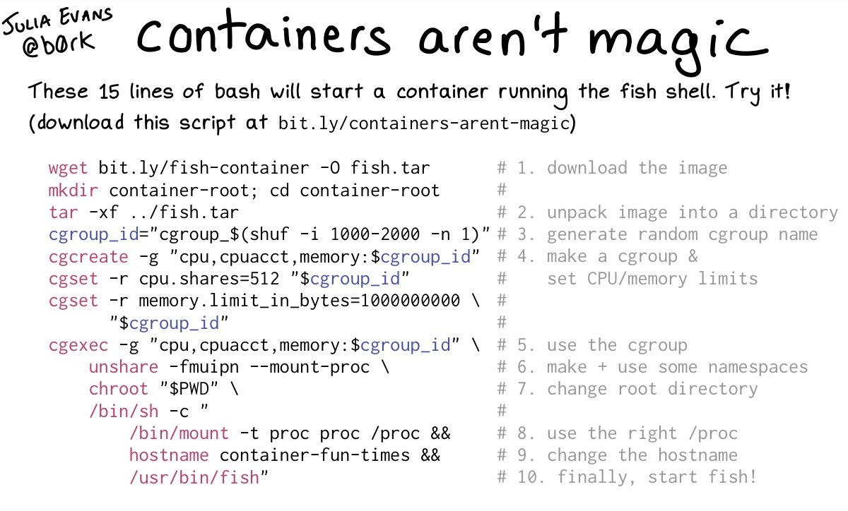
Containers

Slide 6
Registries
NORTH AMERICA - November 2019 All-Hands Call
Notes:
Instructor ToolKit
MOJO - New Site
RHLC
Knowledge management
RHU ROL / public ROL

Slide 7
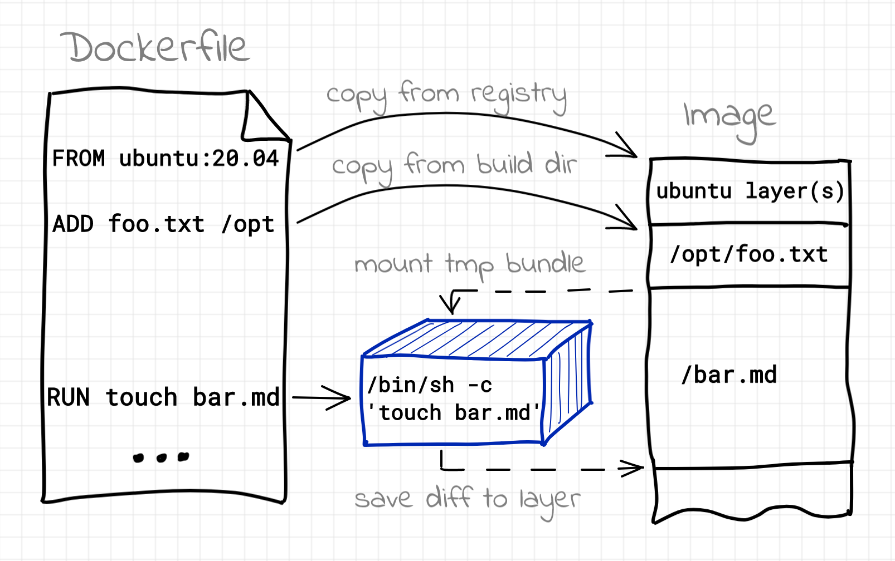
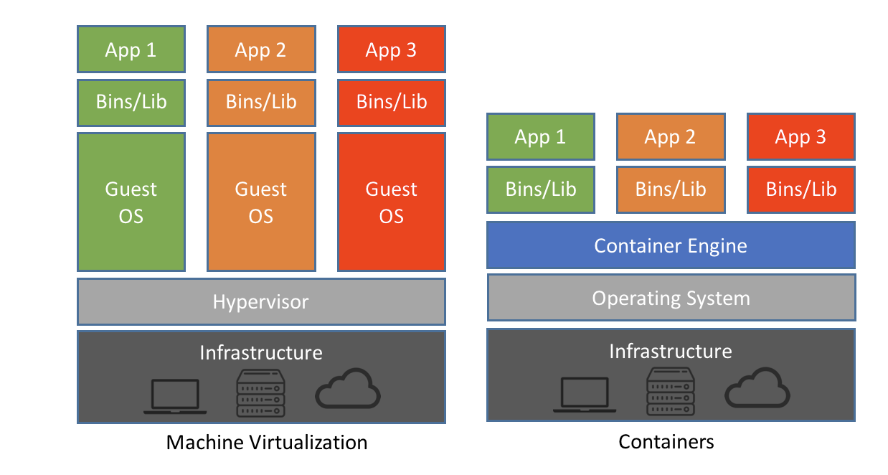
Container Image
A container image, in its simplest definition, is a file which is pulled down from a Registry Server and used locally as a mount point when starting Containers. Container images can be built based on instructions called Dockerfiles.
https://developers.redhat.com/blog/2018/02/22/container-terminology-practical-introduction

Slide 8
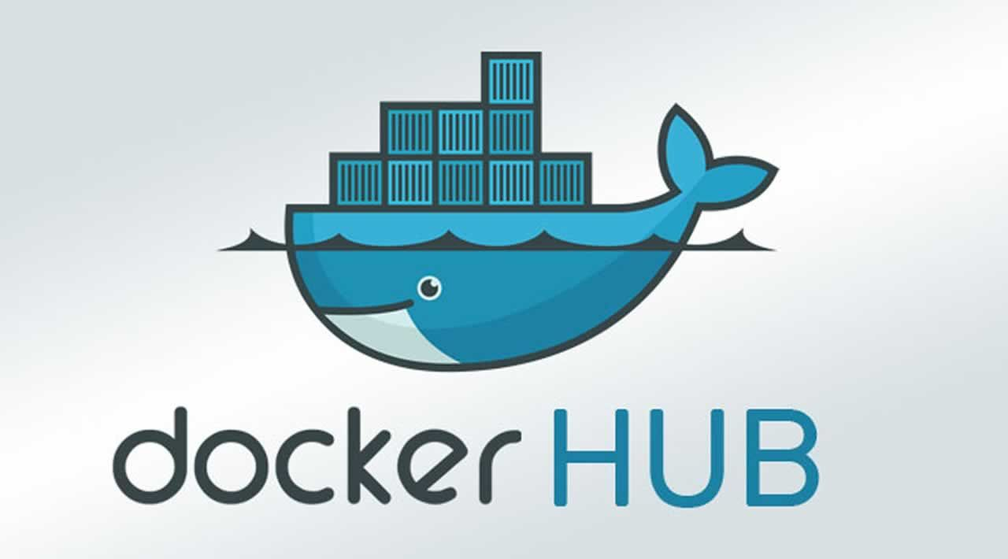
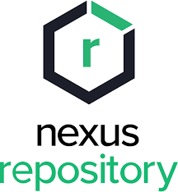
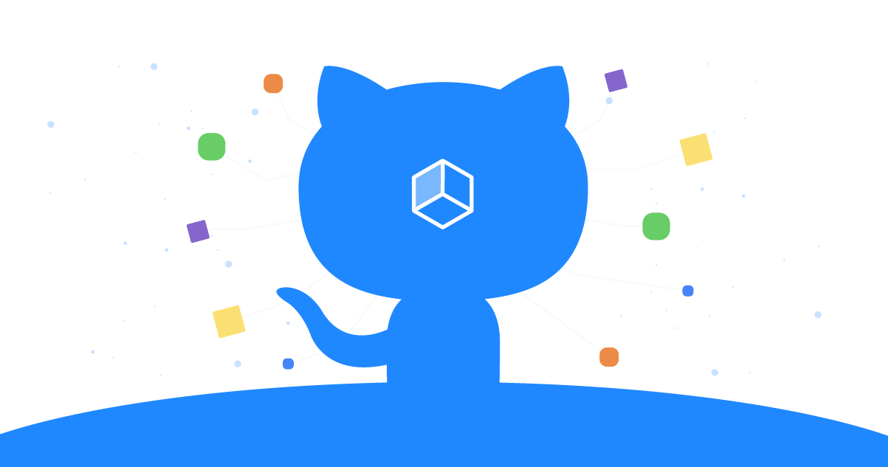

Container Image Registries
A container registry is a repository, or collection of repositories, used to store container images for Kubernetes, DevOps, and container-based application development.
https://www.redhat.com/en/topics/cloud-native-apps/what-is-a-container-registry#:~:text=A%20container%20registry%20is%20a,and%20container%2Dbased%20application%20development

Slide 9
OpenShift
&
Kubernetes
NORTH AMERICA - November 2019 All-Hands Call

Slide 10
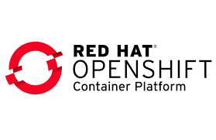
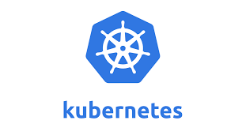
OpenShift and Kubernetes
Kubernetes is an open-source container-orchestration system for automating computer application deployment, scaling, and management. It was originally designed by Google and is now maintained by the Cloud Native Computing Foundation (CNCF). Kubernetes is a portable, extensible, open-source platform for managing containerized workloads and services, that facilitates both declarative configuration and automation
Red Hat® OpenShift® is an enterprise-ready Kubernetes container platform with full-stack automated operations to manage hybrid cloud, multi-cloud, and edge deployments. Extends existing Kubernetes framework with:
Routes
Dashboards (Unified UI)
Monitoring/Metrics/Logging
Integrated Developer workflows supporting CI/CD pipelines and S2I
https://kubernetes.io/docs/concepts/overview/what-is-kubernetes/
https://www.redhat.com/en/technologies/cloud-computing/openshift

Slide 11
Ansible
NORTH AMERICA - November 2019 All-Hands Call

Slide 12
Ansible Introduction & Overview
Ansible – An automation language leveraging modules to be used in one or more tasks on managed systems. Most Ansible automation leverages and Ansible playbook which is a YAML formatted file containing Ansible directives.
Ansible modules – Components used by Ansible tasks and playbooks which are generally implemented and developed in Python. Ansible modules work with certain system utilities and are optimized to be leveraged as a declarative automation language and provide idempotency.
Ansible ad-hoc commands – A way of executing a single Ansible task quickly that relies on a single Ansible module to perform the tests/changes of the task.
Ansible Roles– Curated, independent components of Ansible allowing re-use of common tasks. Roles can consist of variables, tasks, handlers, files, and templates.

Slide 13
Ansible Components & Commands
ansible.cfg – Configuration file for running the ansible and ansible-playbook commands.
Inventory – Inventory file used by the ansible and ansible-playbook commands identifying managed hosts/nodes and also contains Ansible inventory variables.
ansible – Command used to perform/execute Ansible ad-hoc commands against a managed node.
ansible-playbook – Command used to execute and run Ansible playbooks
ansible-galaxy – Command to create or utilize Ansible roles. Many of these roles are published on http://galaxy.ansible.com
Playbook – Collection of Ansible tasks organized into one or more Ansible plays.
Task – Collection/list of Ansible modules arranged into instructions. Each task utilizes an Ansible module to perform a given action.
Ansible Module – Specific module (small program generally implemented in Python) which perform the commands and executes the program to get the desired state of a given task.

Slide 14
Ansible Playbooks
NORTH AMERICA - November 2019 All-Hands Call
Notes:
Instructor ToolKit
MOJO - New Site
RHLC
Knowledge management
RHU ROL / public ROL

Slide 15
Playbook Structure
---
- name: Ansiblize Managed Hosts
hosts: localhost
vars_files:
- variables.yml
tasks:
- name: Create Ansible User
debug:
msg: This will use the USER module
handlers:
- name: Restart SSHD
debug:
msg: This sill use the SERVICE or SYSTEMD

Slide 16
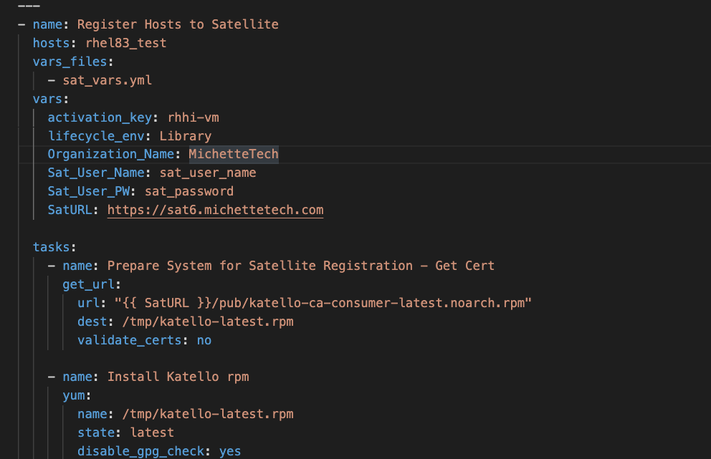
Sample Playbook

Slide 17
Thank you
Red Hat is the world’s leading provider of enterprise open source software solutions. Award-winning support, training, and consulting services make Red Hat a trusted adviser to the Fortune 500.
E-Mail: tmichett@redhat.com

